Slide 1
WinstonAI
https://gowinston.ai/
Conducted 10/20/23
All samples were typed in twice to meet the minimum word count (Samples 9, 14, 17, 25, 29, 37, 48, 55, 56, 59, 60 typed 3x) (Sample 21, 24, 43, 44, 45, 46, 51, 52, 58 typed 4x) (Samples 41, 42, 49 typed 5x)(Samples 50, 57 typed 6x) (Samples 53, 54 typed 7x)

Slide 2
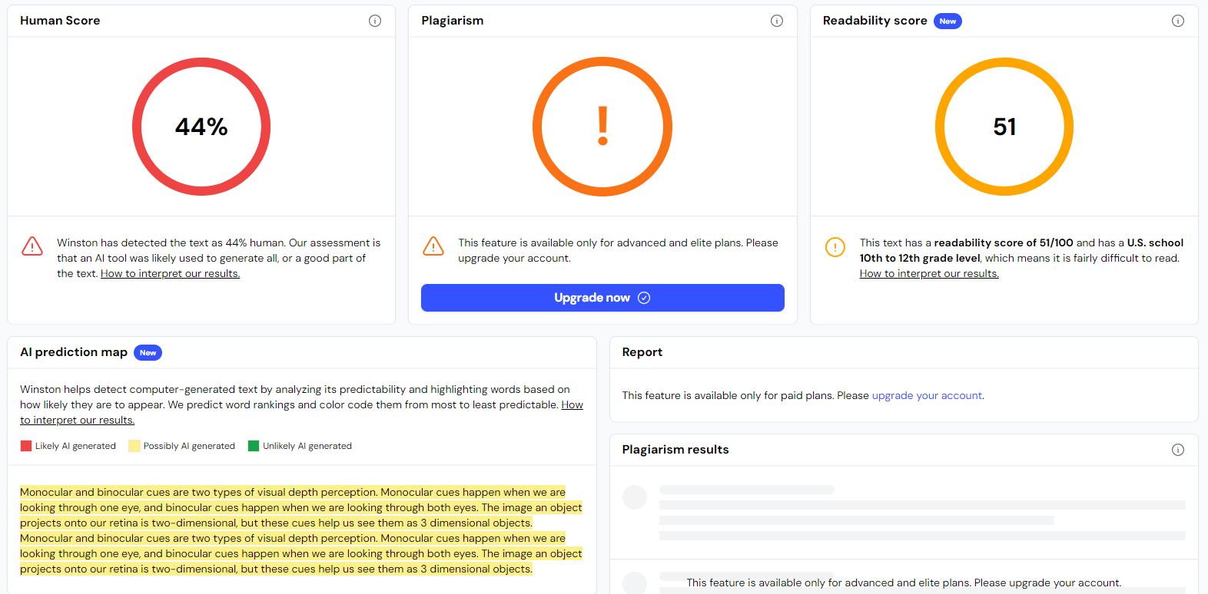
In 2-3 sentences, please explain what monocular and binocular depth cues are. #Sample 1

Slide 3
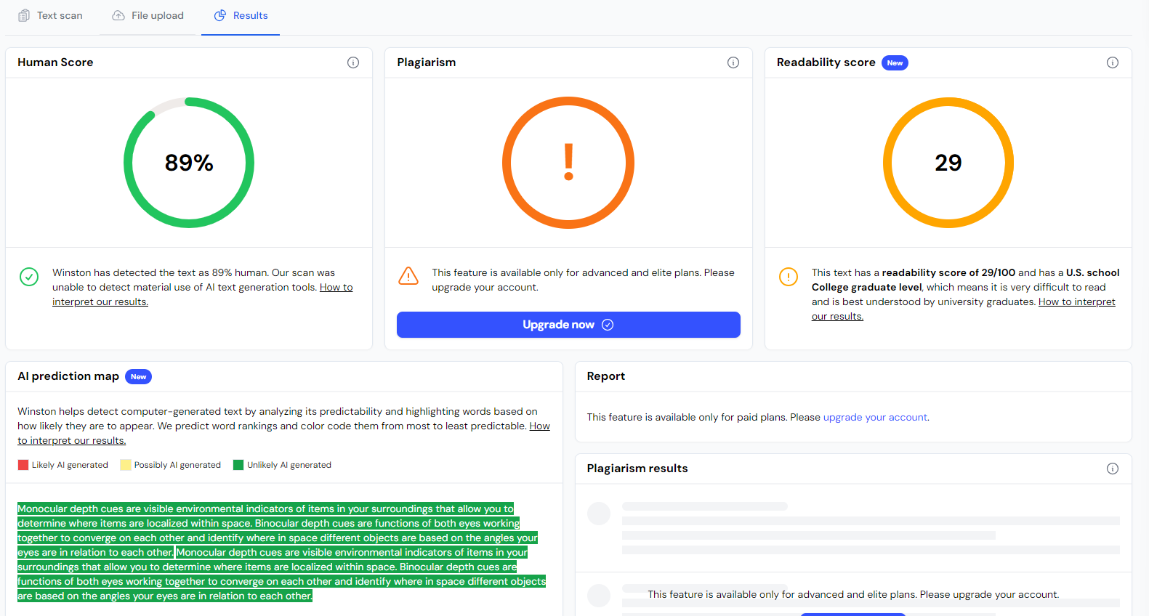
In 2-3 sentences, please explain what monocular and binocular depth cues are. #Sample 2

Slide 4
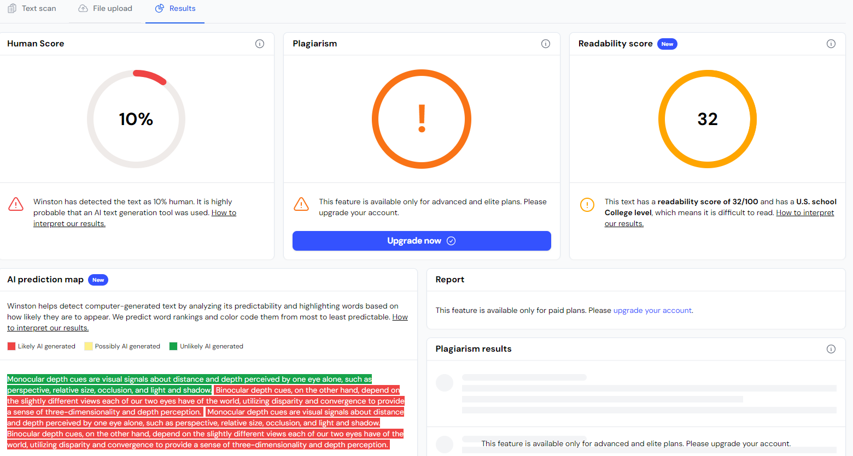
In 2-3 sentences, please explain what monocular and binocular depth cues are. #Sample 3

Slide 5
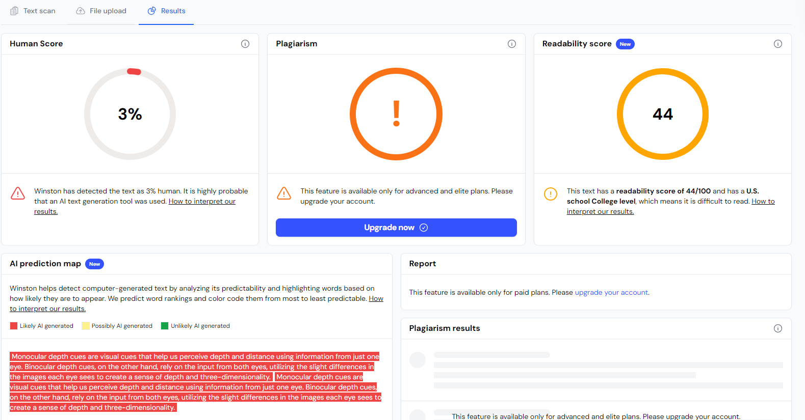
In 2-3 sentences, please explain what monocular and binocular depth cues are. #Sample 4

Slide 6
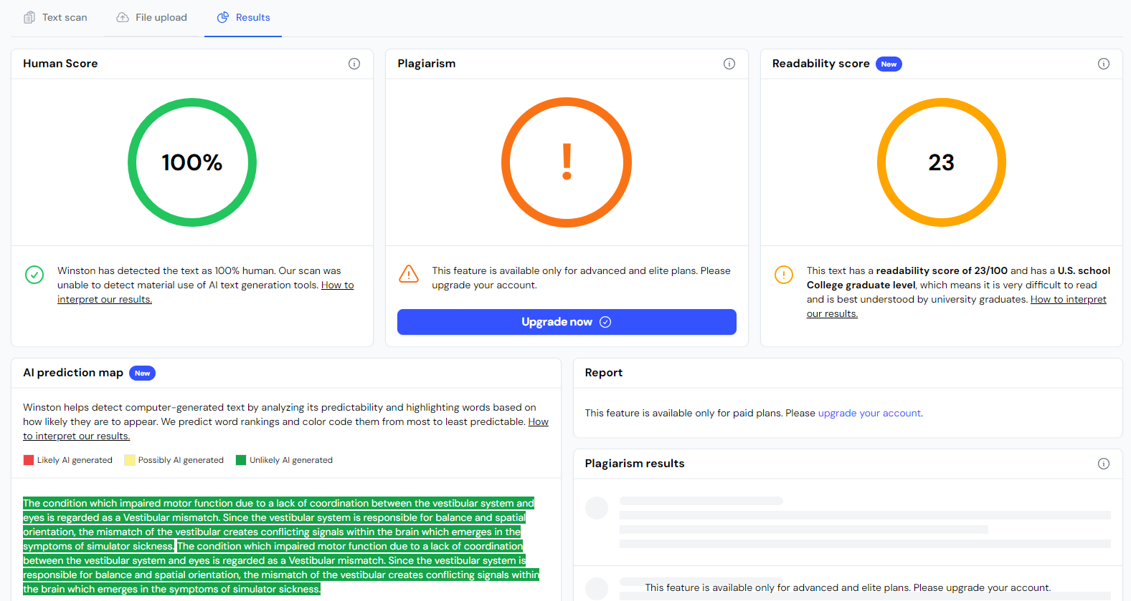
In 2-3 sentences, please explain vestibular mismatch and its effects on simulator sickness. #Sample 5

Slide 7
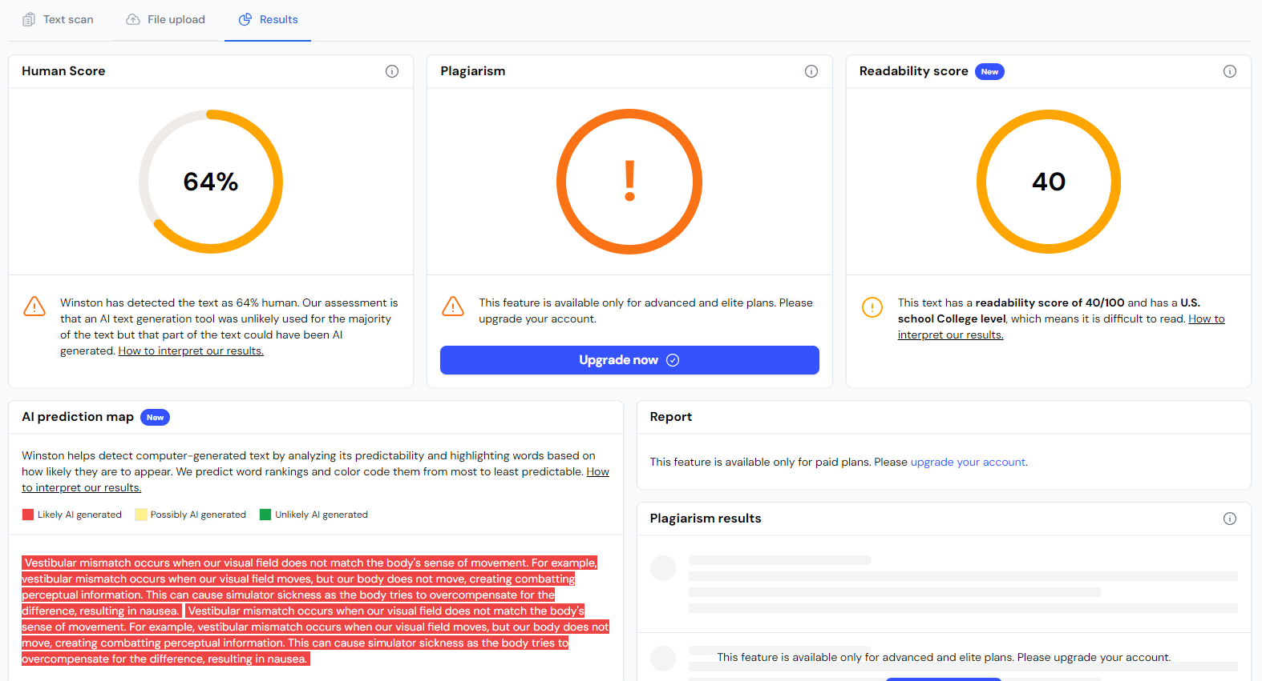
In 2-3 sentences, please explain vestibular mismatch and its effects on simulator sickness. #Sample 6

Slide 8
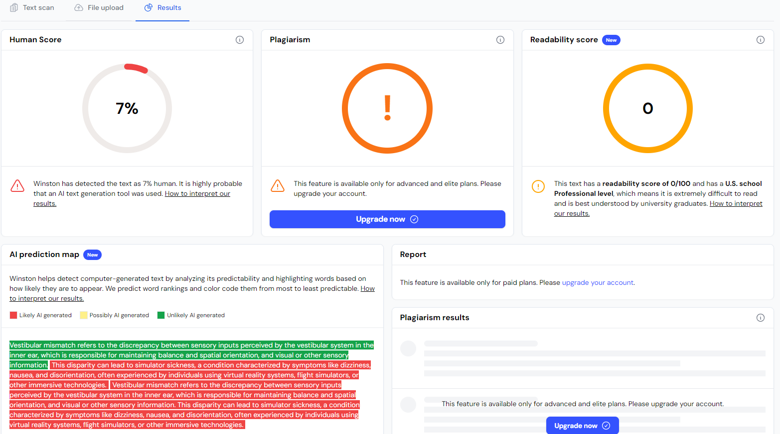
In 2-3 sentences, please explain vestibular mismatch and its effects on simulator sickness. #Sample 7

Slide 9
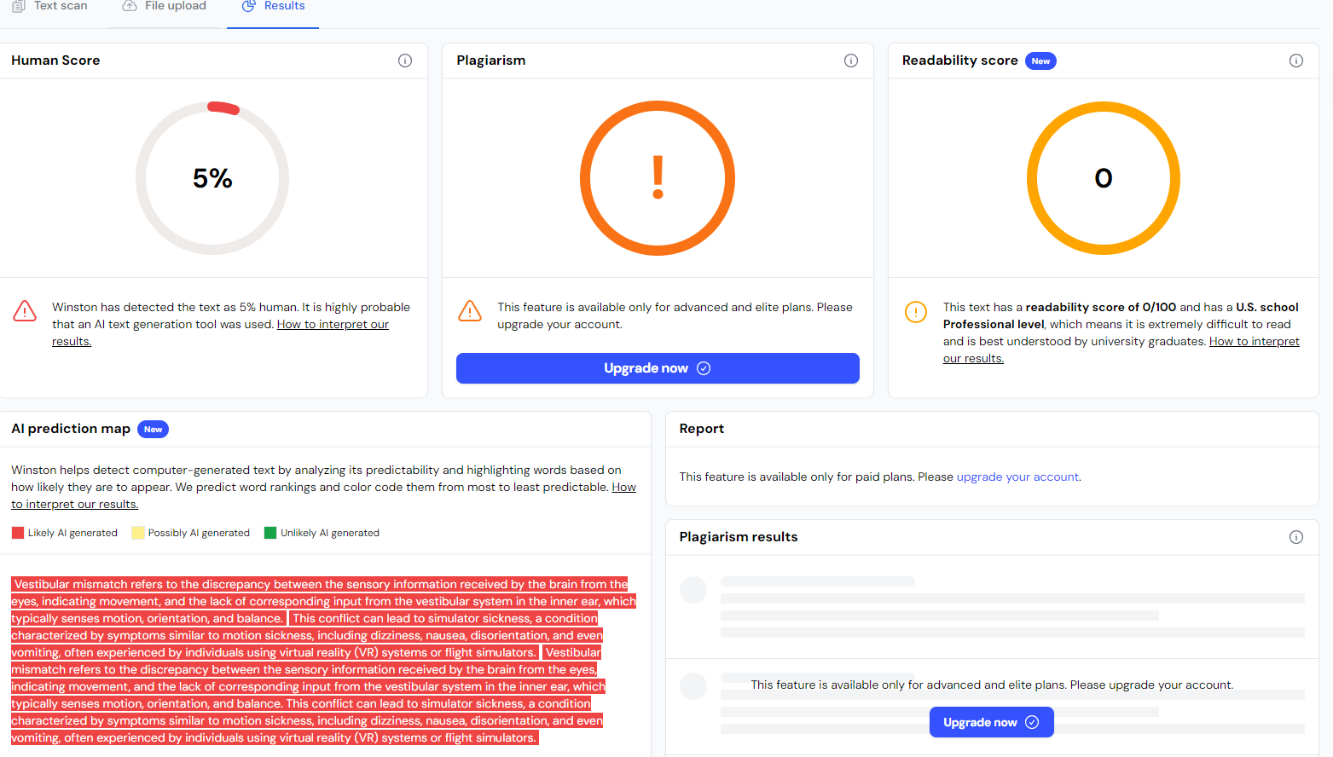
In 2-3 sentences, please explain vestibular mismatch and its effects on simulator sickness. #Sample 8

Slide 10
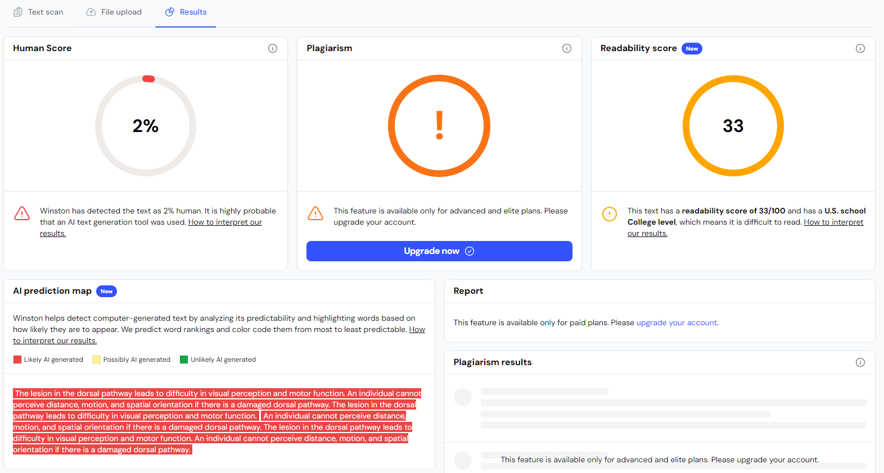
In 2-3 sentences, please explain cognitive impacts of a lesion in the dorsal pathway. #Sample 9

Slide 11
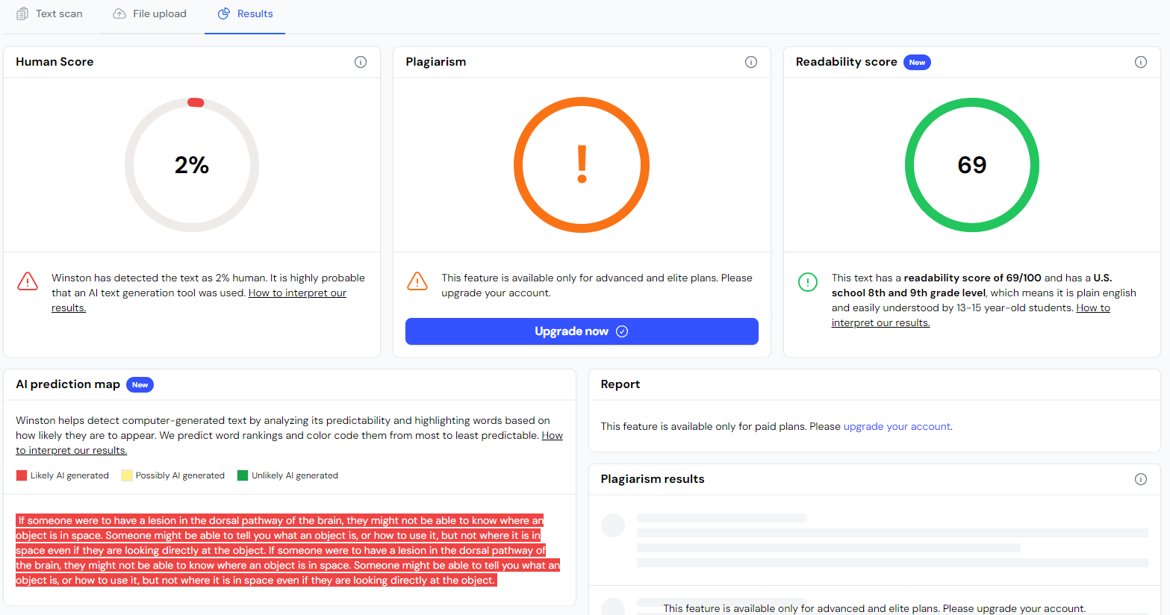
In 2-3 sentences, please explain cognitive impacts of a lesion in the dorsal pathway. #Sample 10

Slide 12
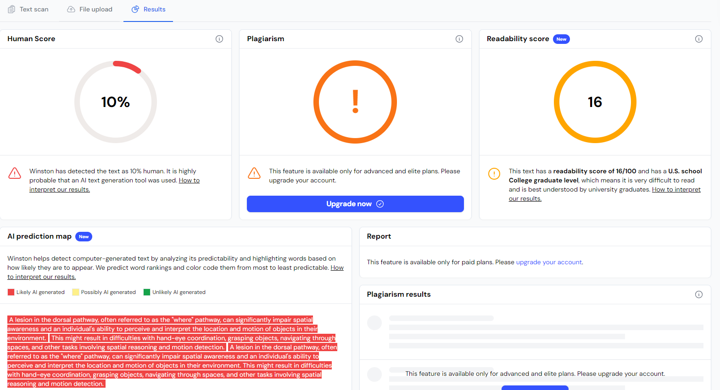
In 2-3 sentences, please explain cognitive impacts of a lesion in the dorsal pathway. #Sample 11

Slide 13
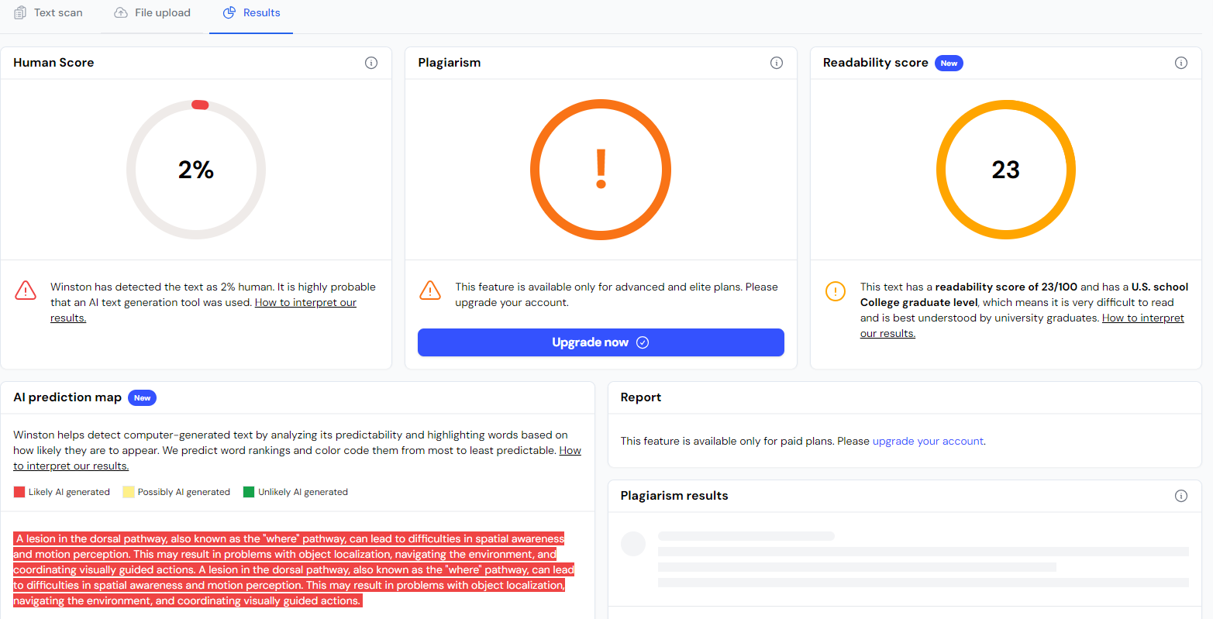
In 2-3 sentences, please explain cognitive impacts of a lesion in the dorsal pathway. #Sample 12

Slide 14
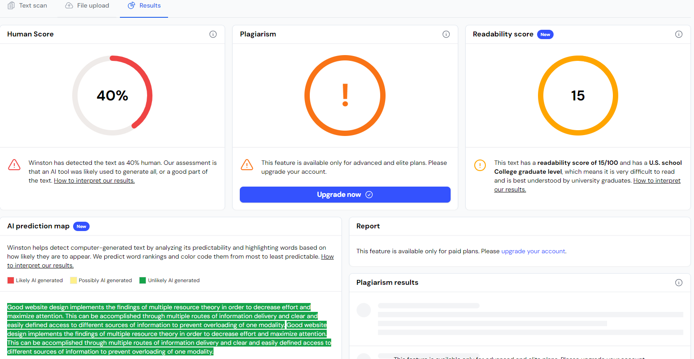
In 2-3 sentences, please explain how to apply multiple resource theory to website design. #Sample 13

Slide 15
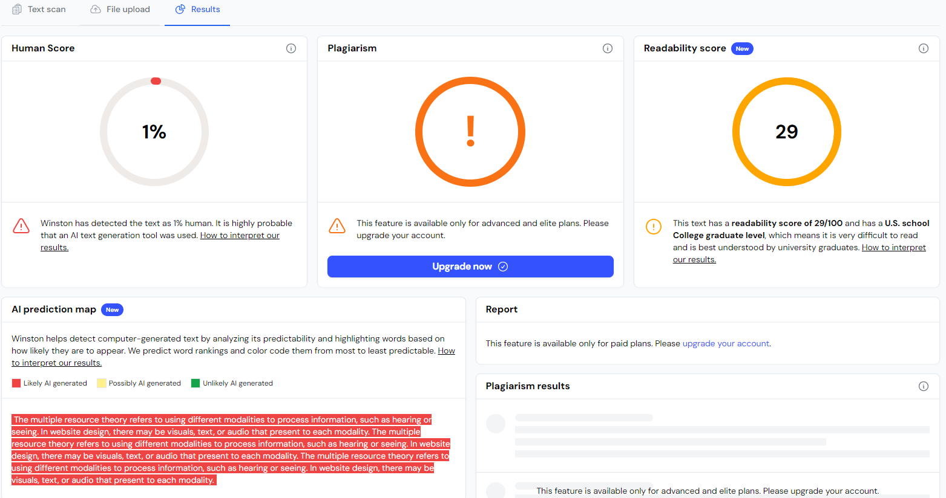
In 2-3 sentences, please explain how to apply multiple resource theory to website design. #Sample 14

Slide 16
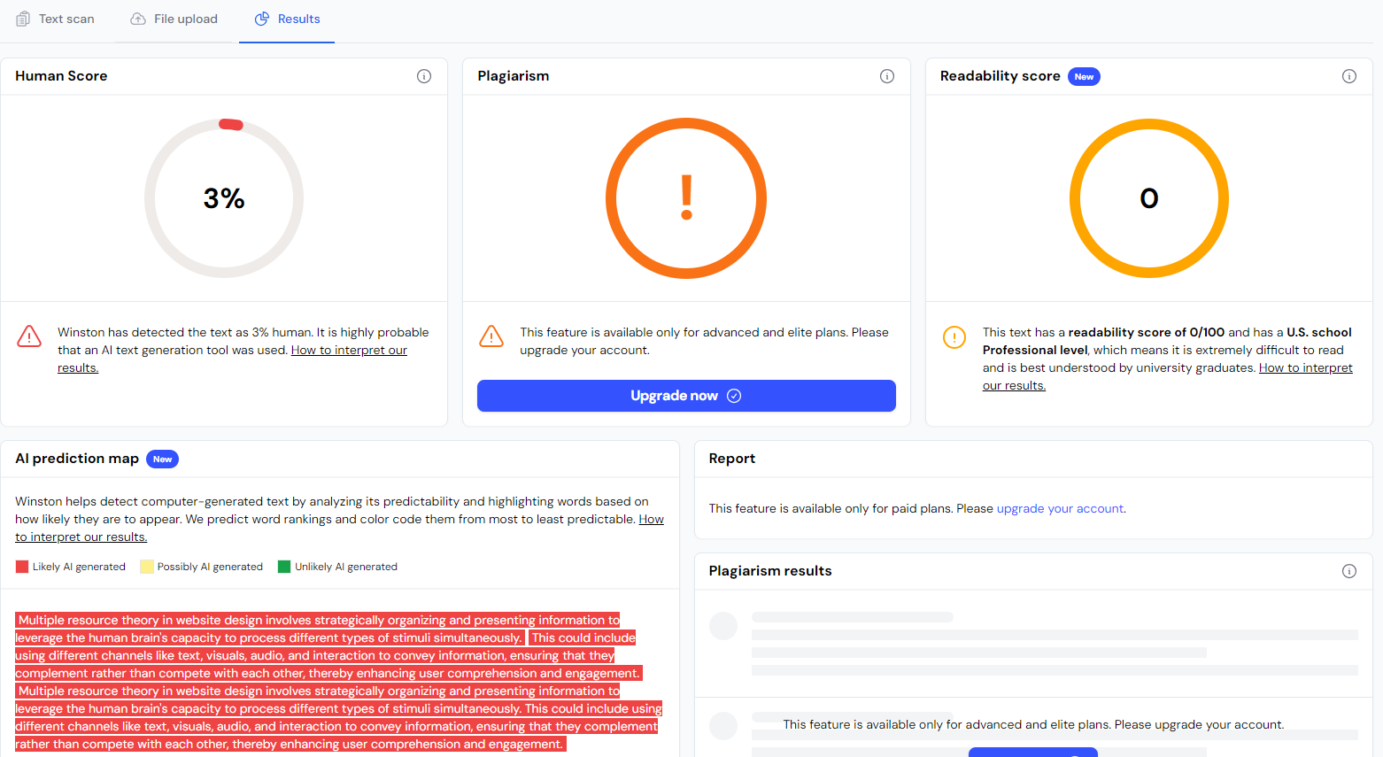
In 2-3 sentences, please explain how to apply multiple resource theory to website design. #Sample 15

Slide 17
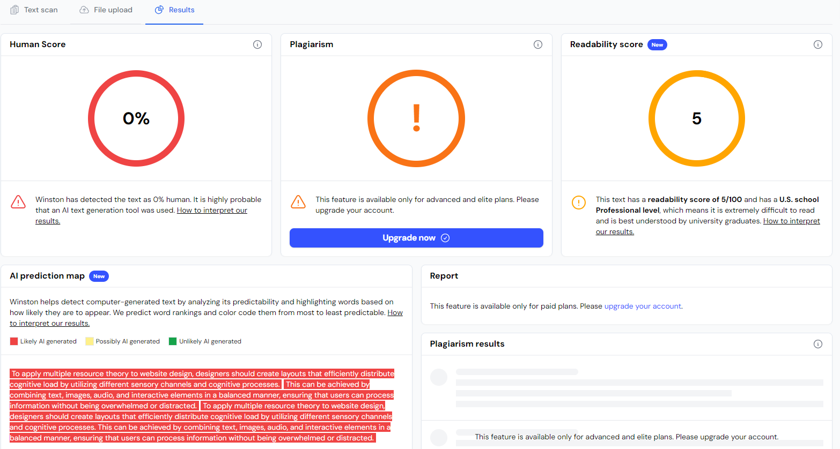
In 2-3 sentences, please explain how to apply multiple resource theory to website design. #Sample 16

Slide 18
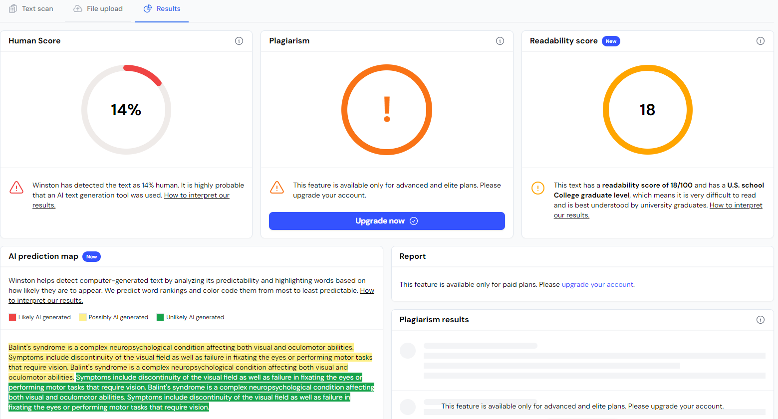
In 2-3 sentences, please explain the effects of Balint's syndrome. #Sample 17

Slide 19
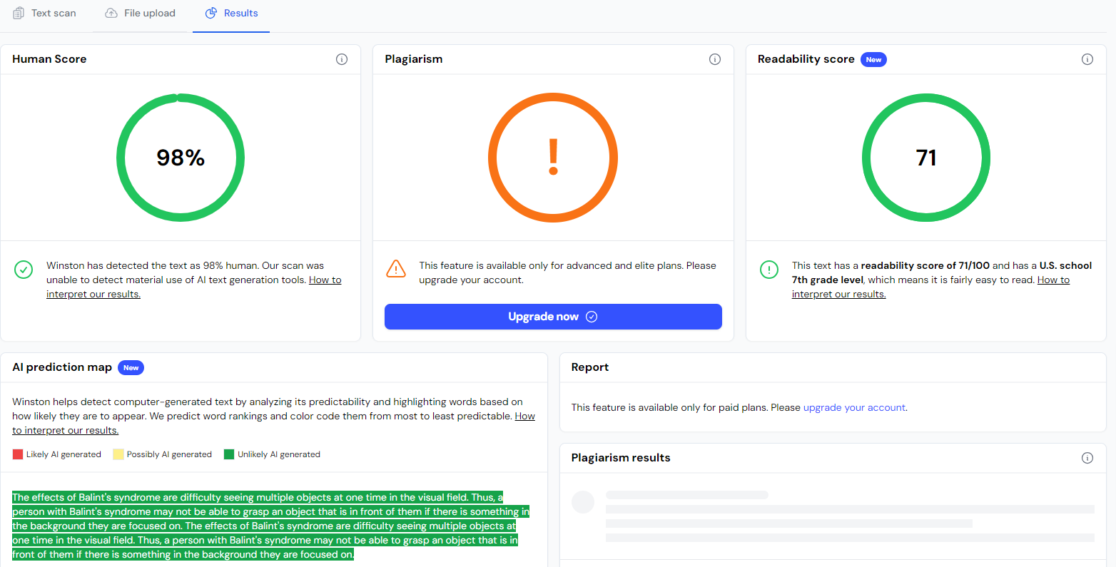
In 2-3 sentences, please explain the effects of Balint's syndrome. #Sample 18

Slide 20
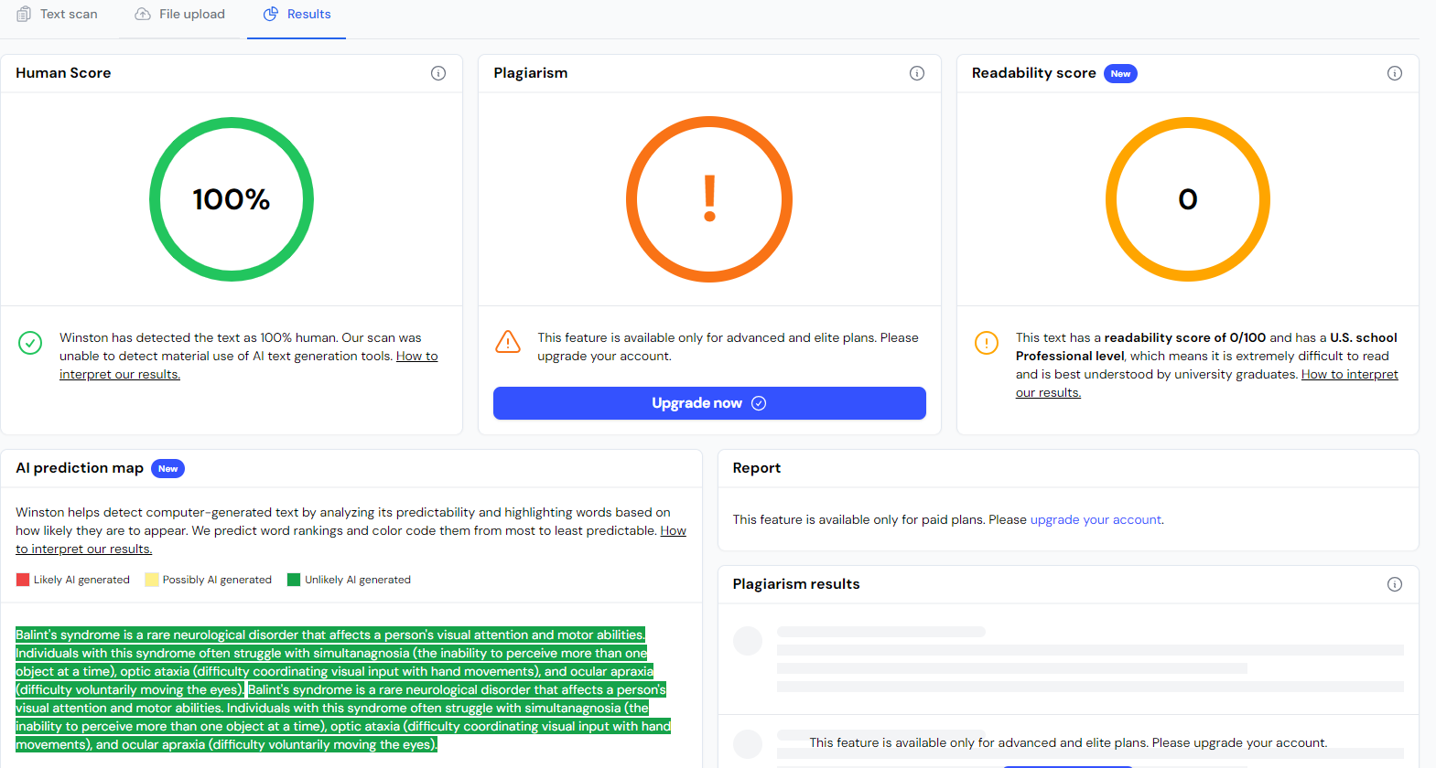
In 2-3 sentences, please explain the effects of Balint's syndrome. #Sample 19

Slide 21
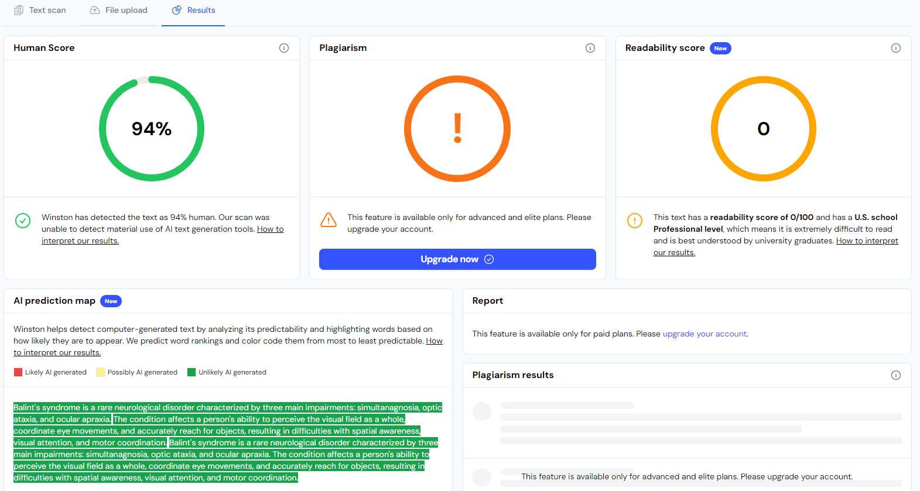
In 2-3 sentences, please explain the effects of Balint's syndrome. #Sample 20

Slide 22
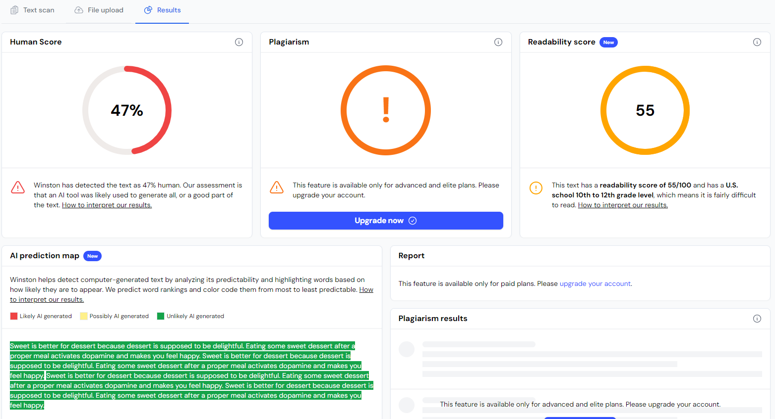
In 2-3 sentences, which one is better for dessert, something sweet or something savory? #Sample 21

Slide 23

In 2-3 sentences, which one is better for dessert, something sweet or something savory? #Sample 22

Slide 24
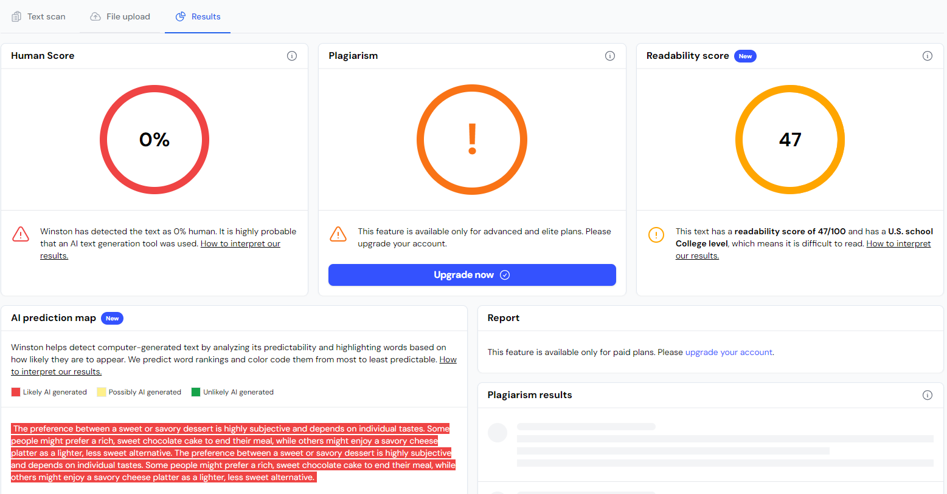
In 2-3 sentences, which one is better for dessert, something sweet or something savory? #Sample 23

Slide 25
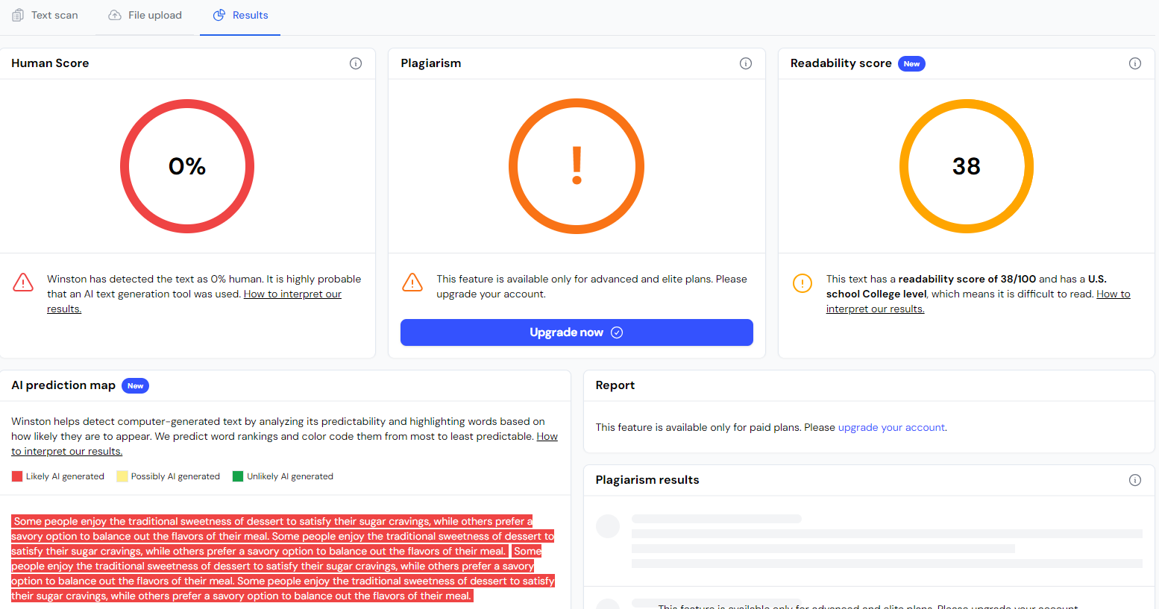
In 2-3 sentences, which one is better for dessert, something sweet or something savory? #Sample 24

Slide 26
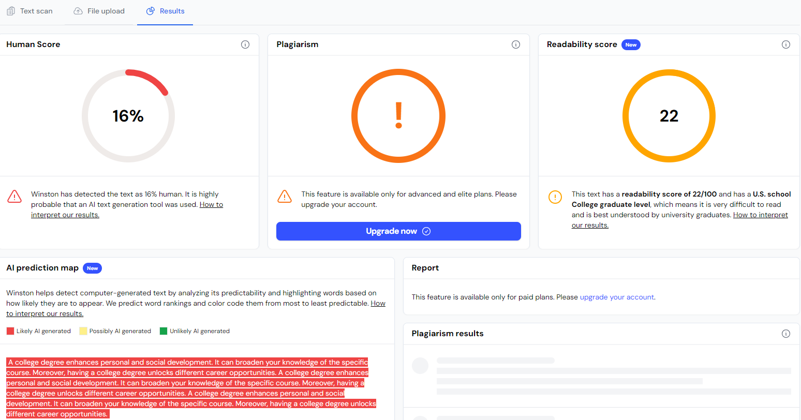
In 2-3 sentences, why should someone get a college degree? #Sample 25

Slide 27
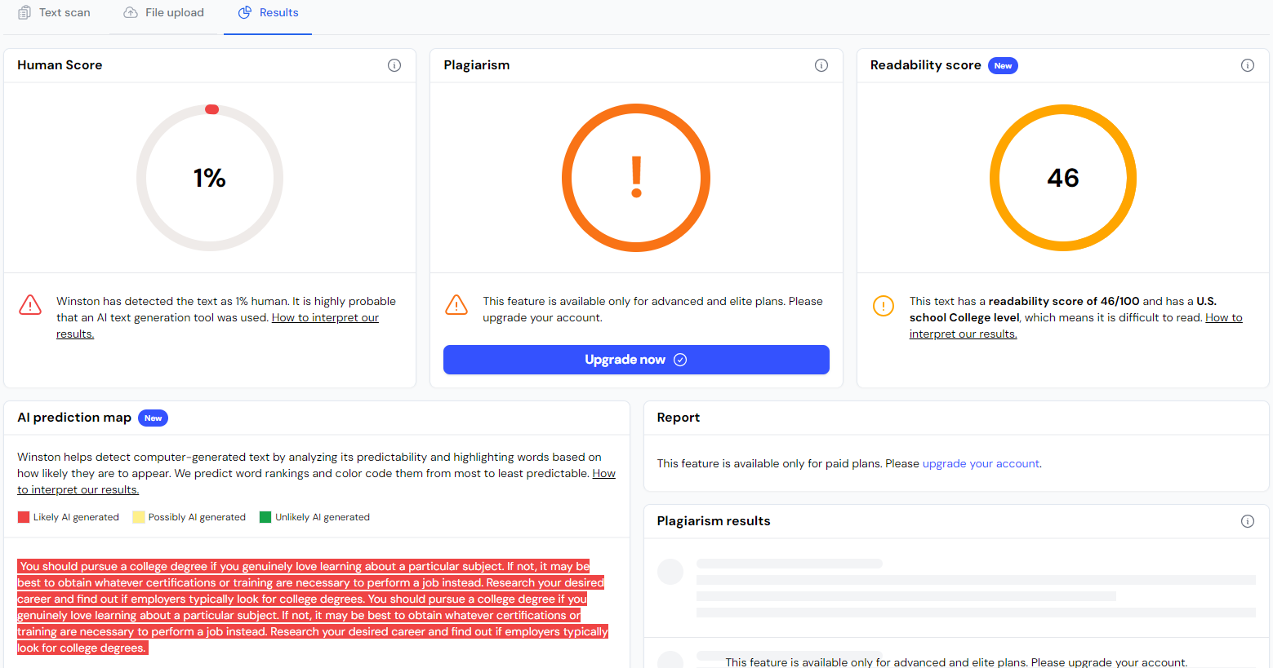
In 2-3 sentences, why should someone get a college degree? #Sample 26

Slide 28
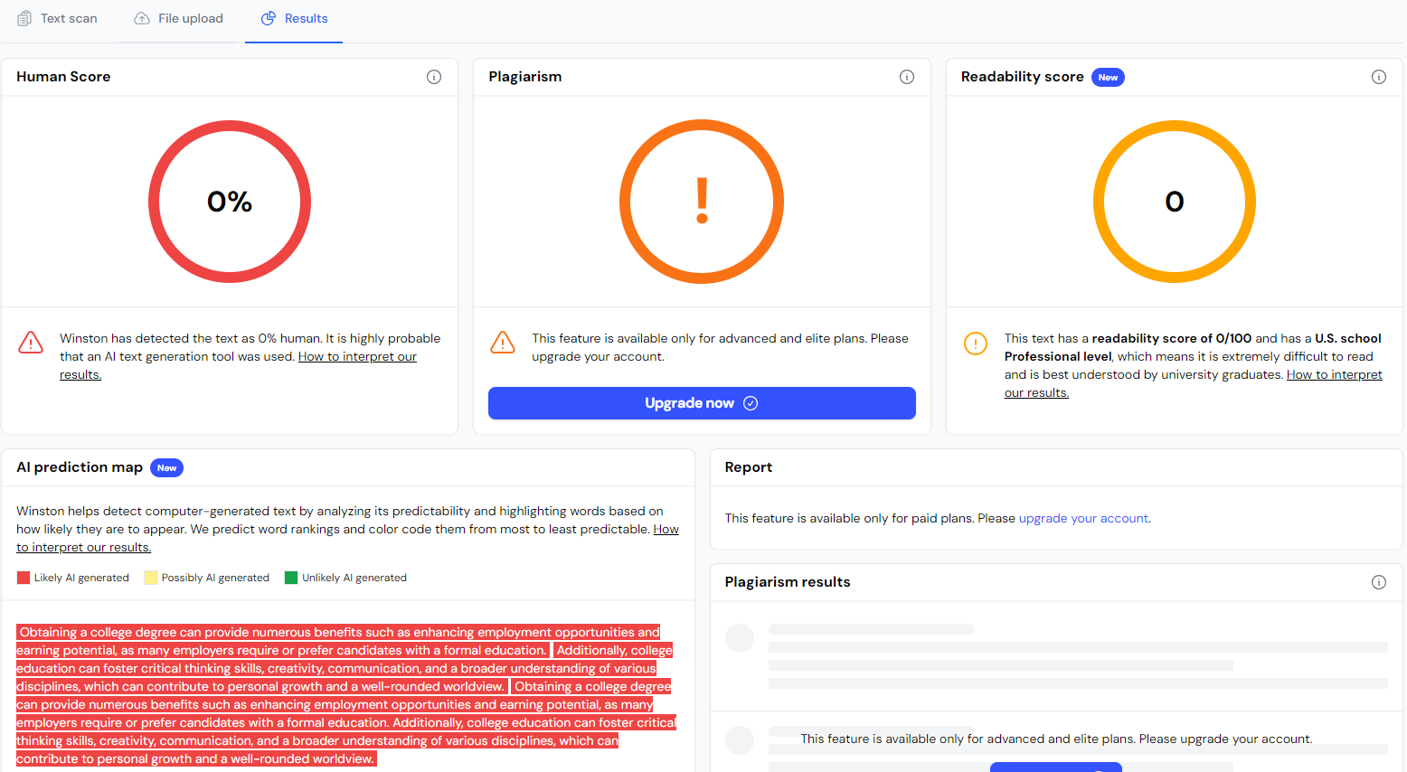
In 2-3 sentences, why should someone get a college degree? #Sample 27

Slide 29
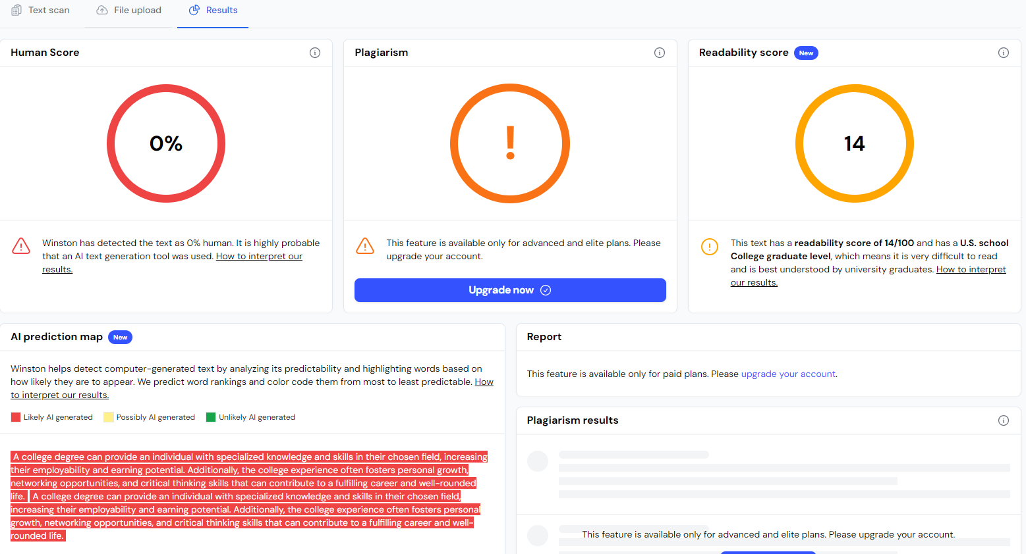
In 2-3 sentences, why should someone get a college degree? #Sample 28

Slide 30
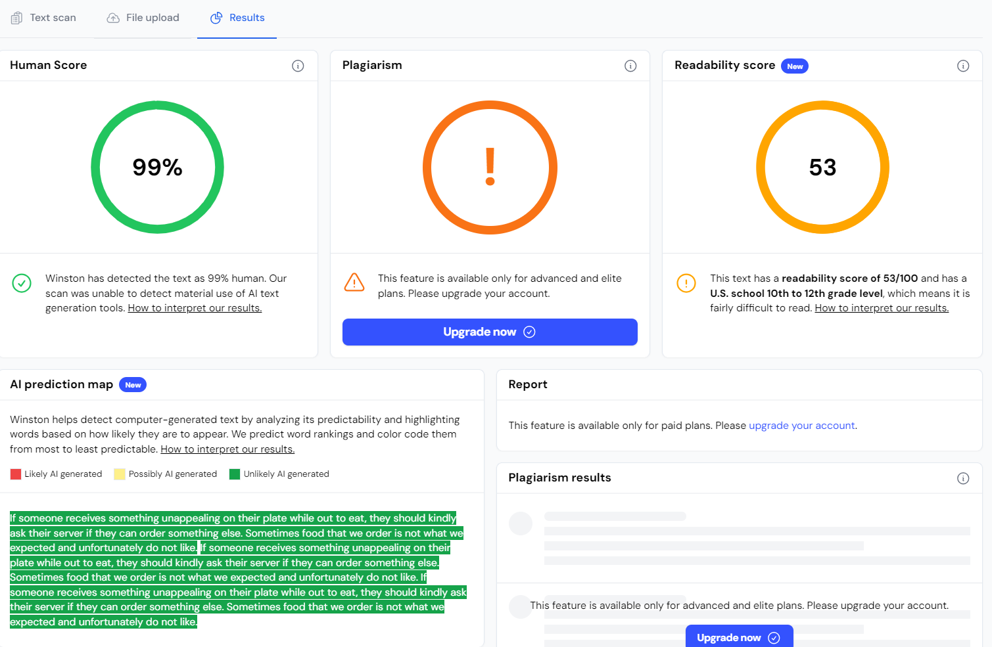
In 2-3 sentences, what should someone do if they receive something unappealing on their plate while eating “out.” #Sample 29

Slide 31
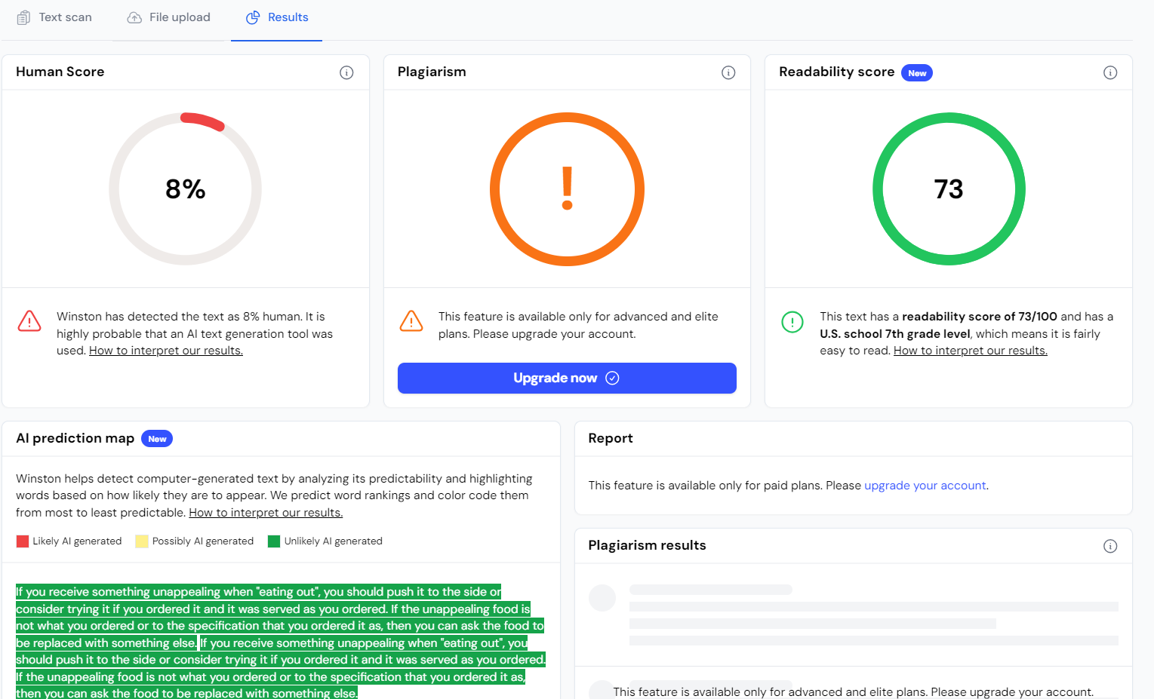
In 2-3 sentences, what should someone do if they receive something unappealing on their plate while eating “out.” #Sample 30

Slide 32
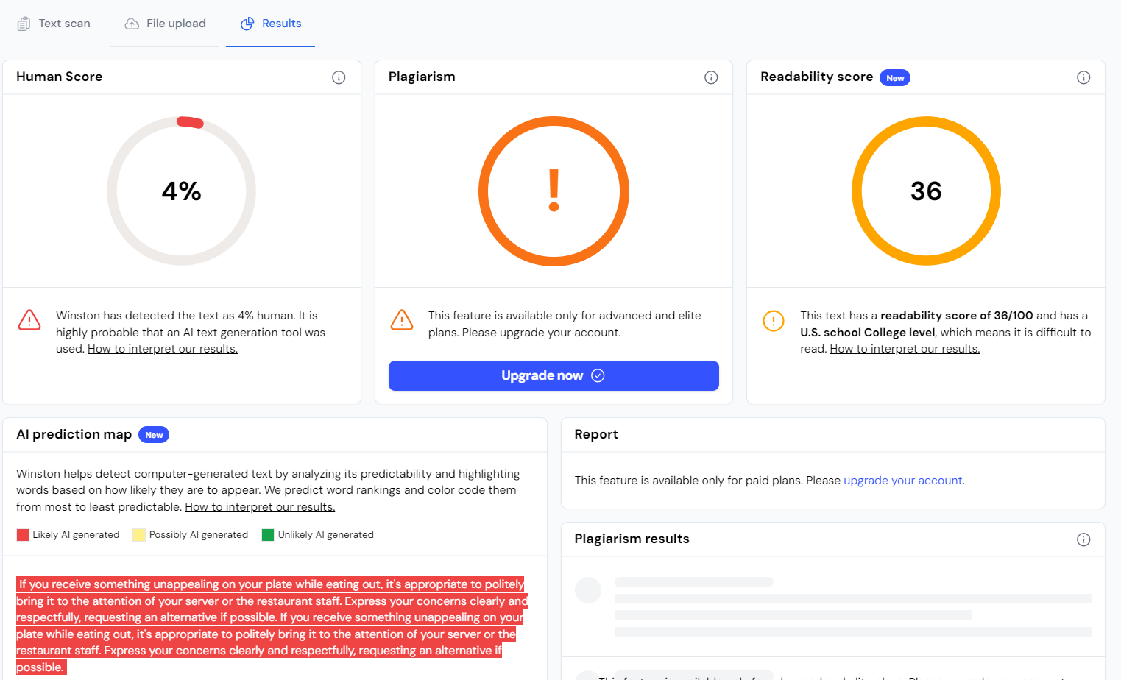
In 2-3 sentences, what should someone do if they receive something unappealing on their plate while eating “out.” #Sample 31

Slide 33
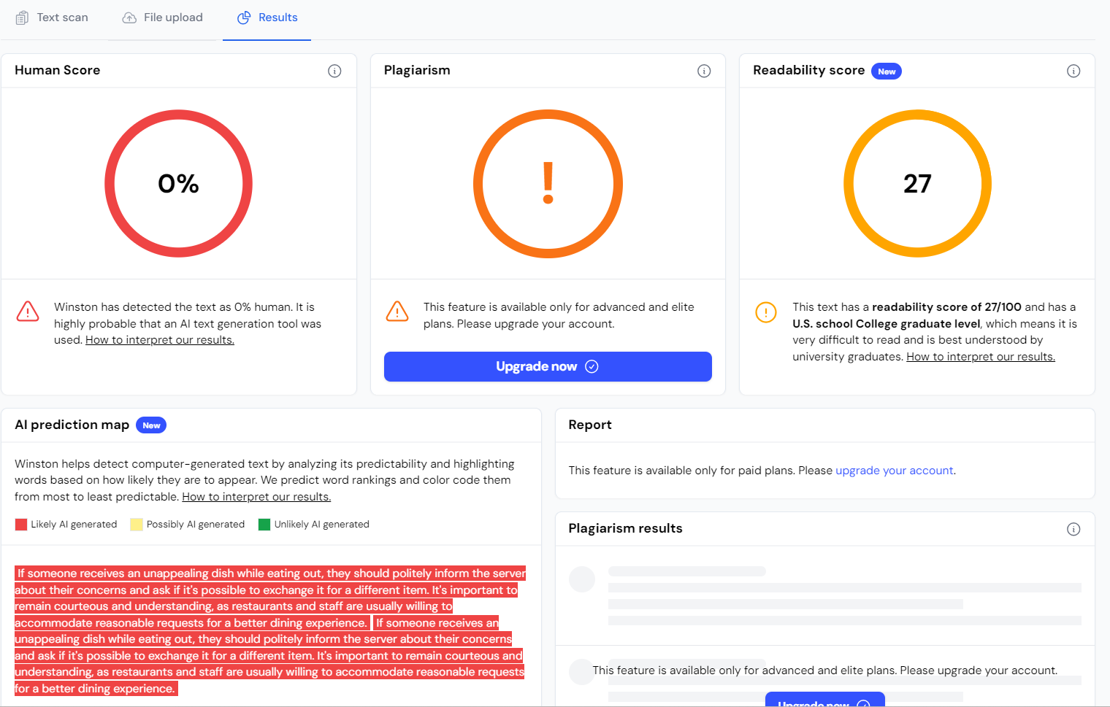
In 2-3 sentences, what should someone do if they receive something unappealing on their plate while eating “out.” #Sample 32

Slide 34
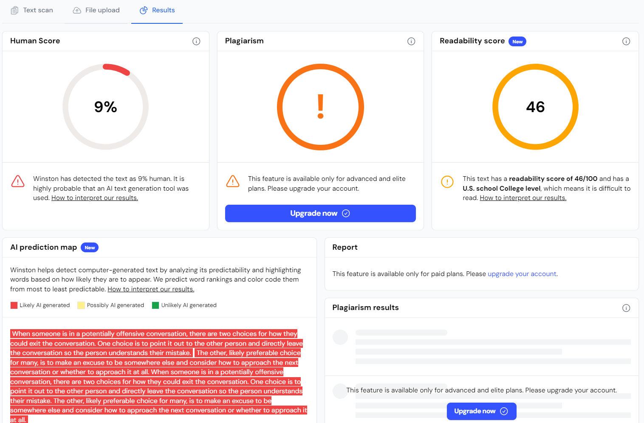
In 2-3 sentences, please explain how someone should exit a conversation when the other person is saying something that could be considered offensive. #Sample 33

Slide 35
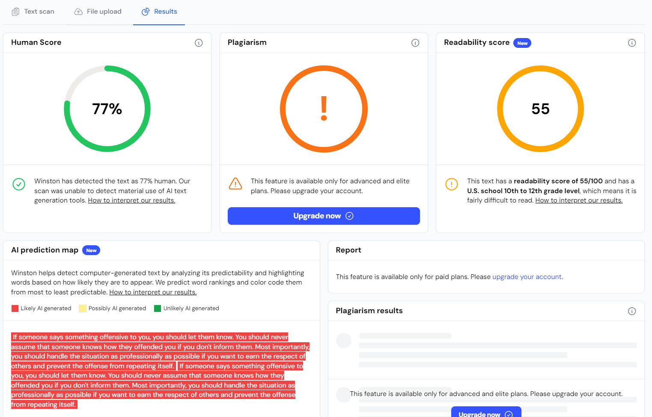
In 2-3 sentences, please explain how someone should exit a conversation when the other person is saying something that could be considered offensive. #Sample 34

Slide 36

In 2-3 sentences, please explain how someone should exit a conversation when the other person is saying something that could be considered offensive. #Sample 35

Slide 37
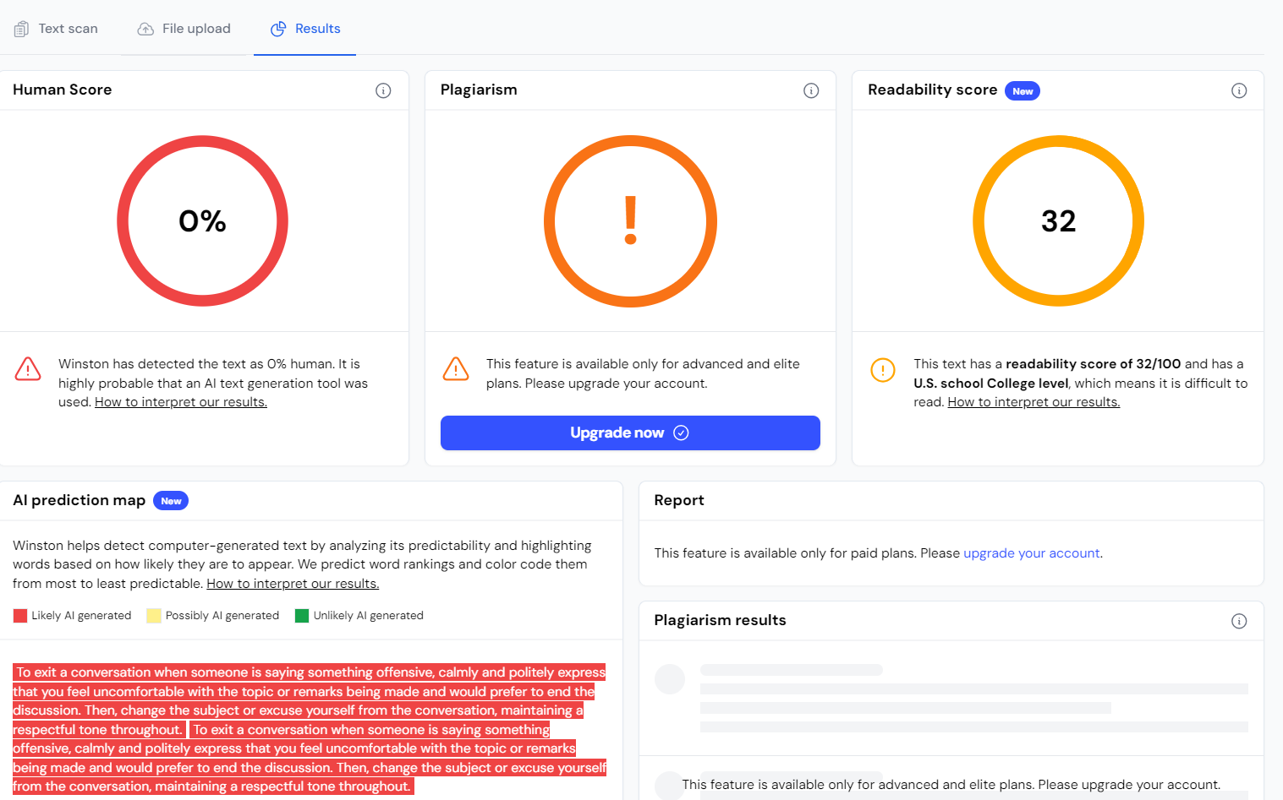
In 2-3 sentences, please explain how someone should exit a conversation when the other person is saying something that could be considered offensive. #Sample 36

Slide 38
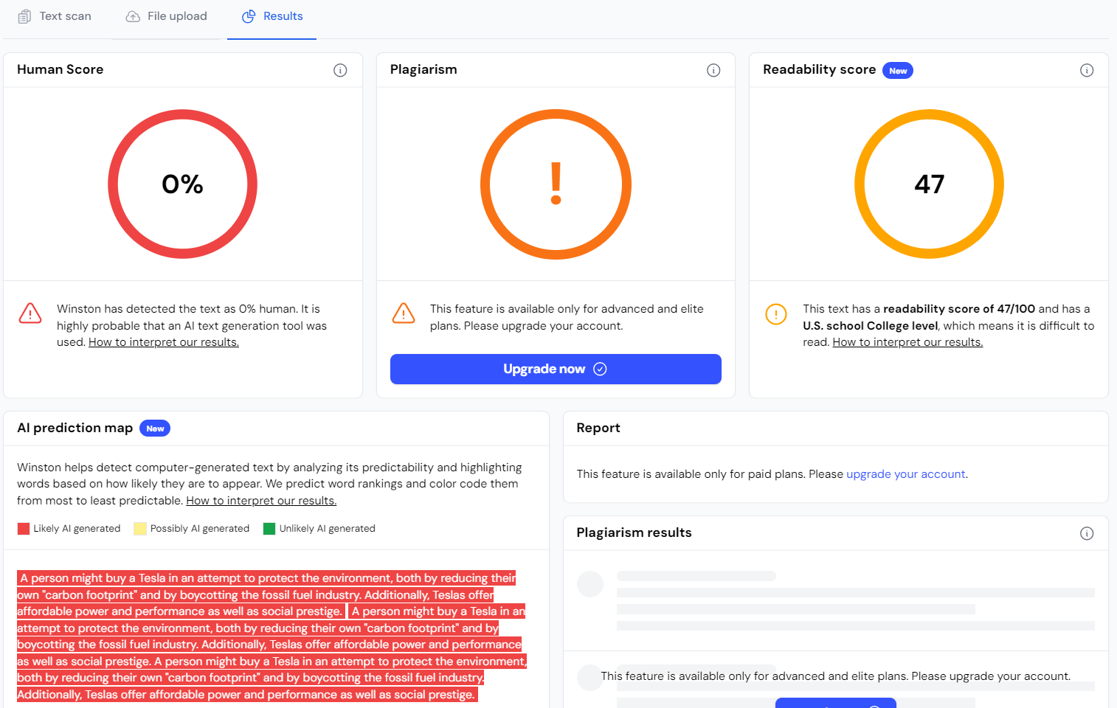
In 2-3 sentences, why should someone buy a Tesla? #Sample - 37

Slide 39
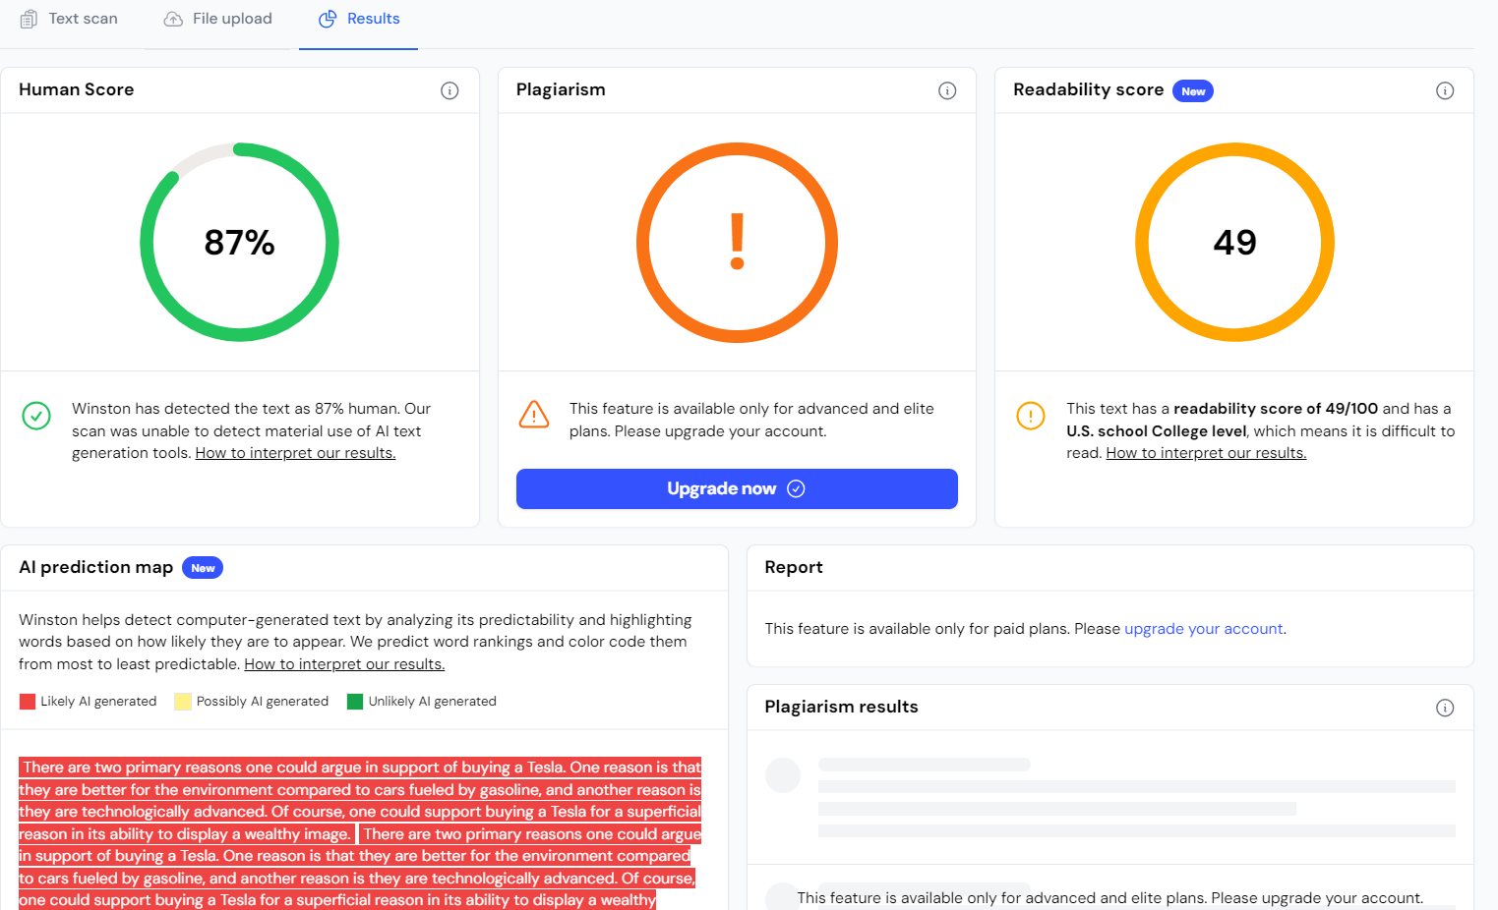
In 2-3 sentences, why should someone buy a Tesla? #Sample - 38

Slide 40

In 2-3 sentences, why should someone buy a Tesla? #Sample - 39

Slide 41

In 2-3 sentences, why should someone buy a Tesla? #Sample - 40

Slide 42
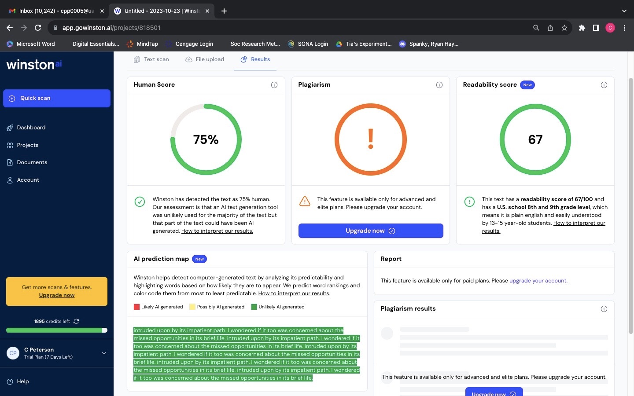
Write 4 more lines of a poem based on the first two lines provided. "Dying" by Emily Dickinson: I heard a fly buzz when I died; the stillness round my form #Sample - 41

Slide 43
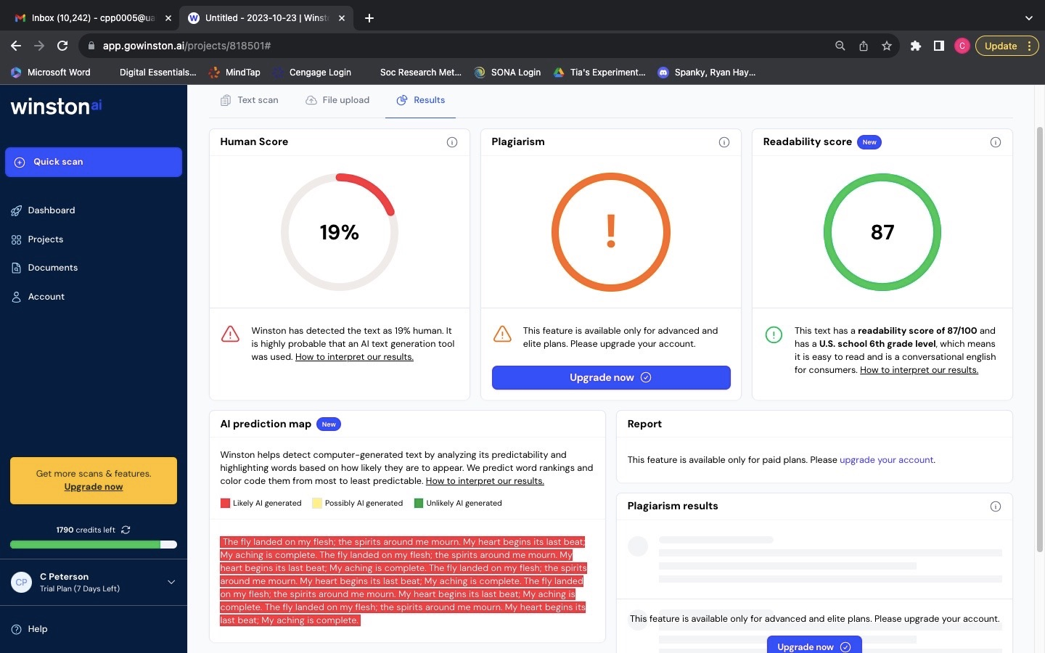
Write 4 more lines of a poem based on the first two lines provided. "Dying" by Emily Dickinson: I heard a fly buzz when I died; the stillness round my form #Sample - 42

Slide 44
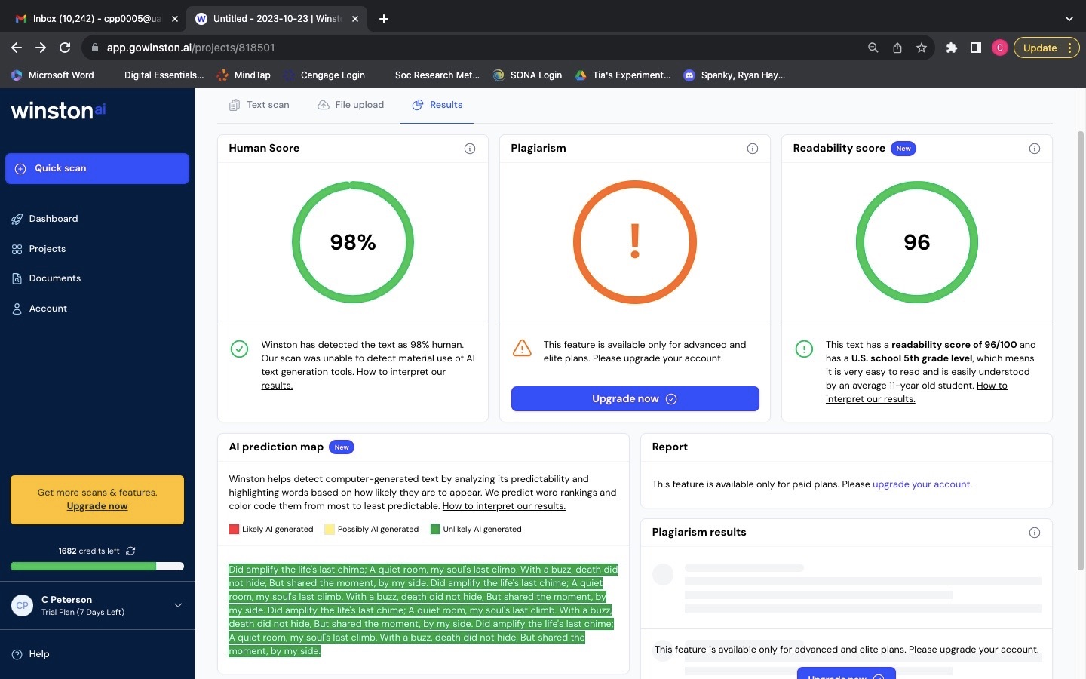
Write 4 more lines of a poem based on the first two lines provided. "Dying" by Emily Dickinson: I heard a fly buzz when I died; the stillness round my form #Sample - 43

Slide 45
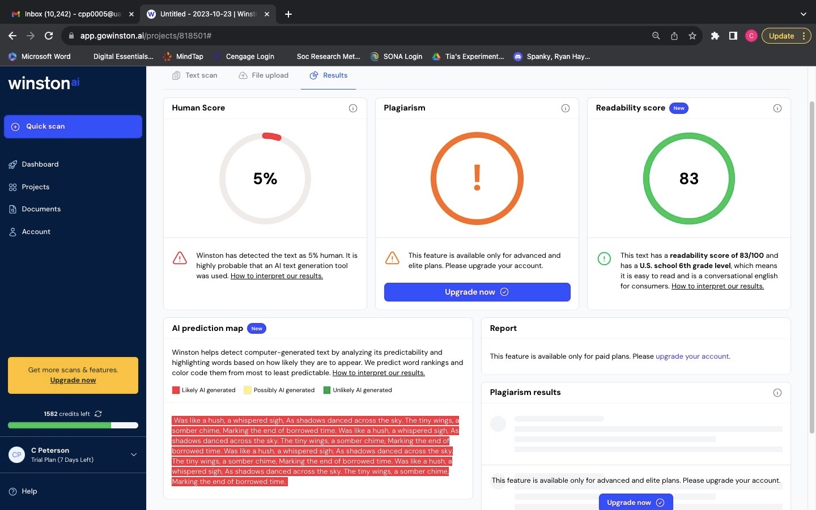
Write 4 more lines of a poem based on the first two lines provided. "Dying" by Emily Dickinson: I heard a fly buzz when I died; the stillness round my form #Sample - 44

Slide 46
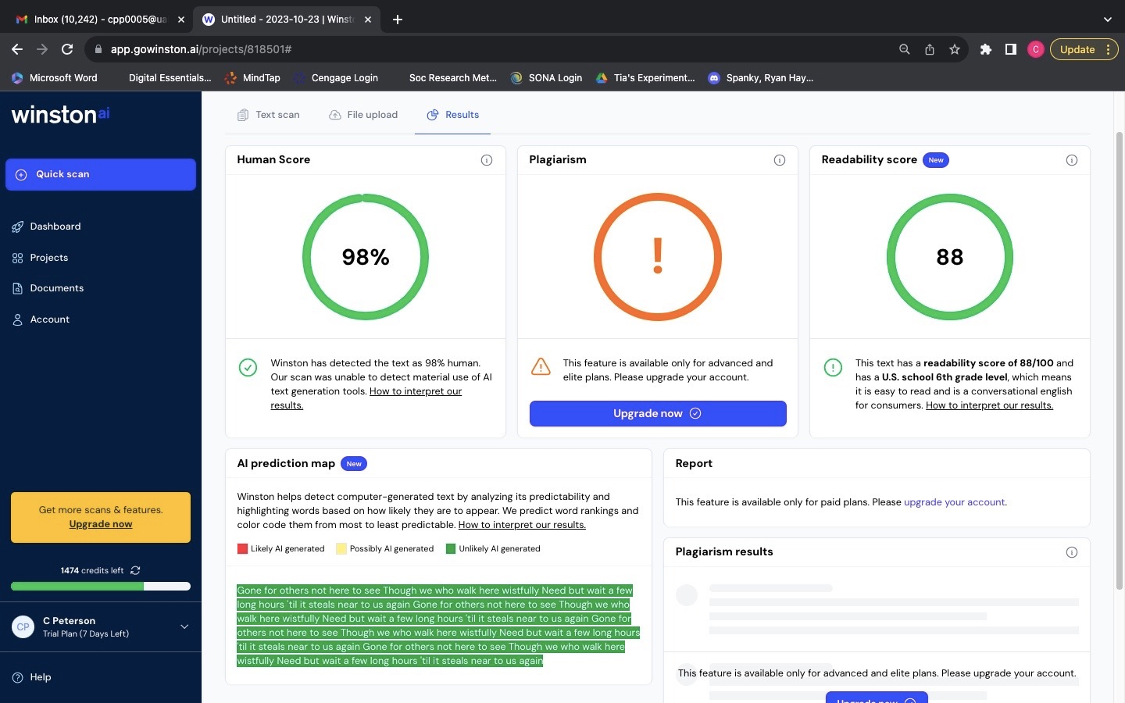
Write 4 more lines of a poem based on the first two lines provided. "A Sea-Side Walk" by Elizabeth Barrett Browning: We walked beside the sea, After a day which perished silently #Sample – 45

Slide 47
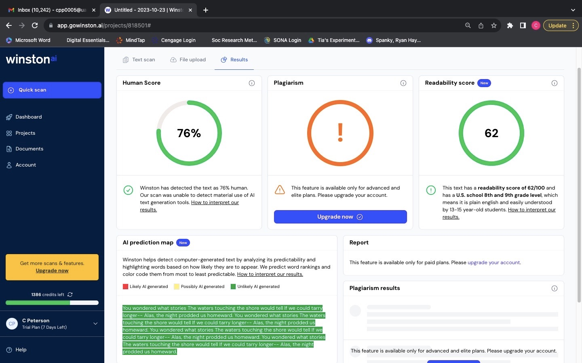
Write 4 more lines of a poem based on the first two lines provided. "A Sea-Side Walk" by Elizabeth Barrett Browning: We walked beside the sea, After a day which perished silently #Sample – 46

Slide 48
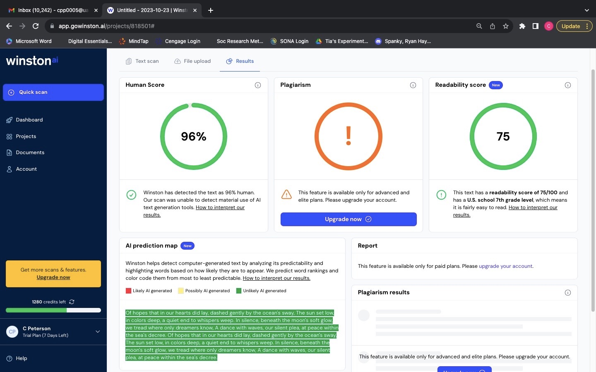
Write 4 more lines of a poem based on the first two lines provided. "A Sea-Side Walk" by Elizabeth Barrett Browning: We walked beside the sea, After a day which perished silently #Sample – 47

Slide 49
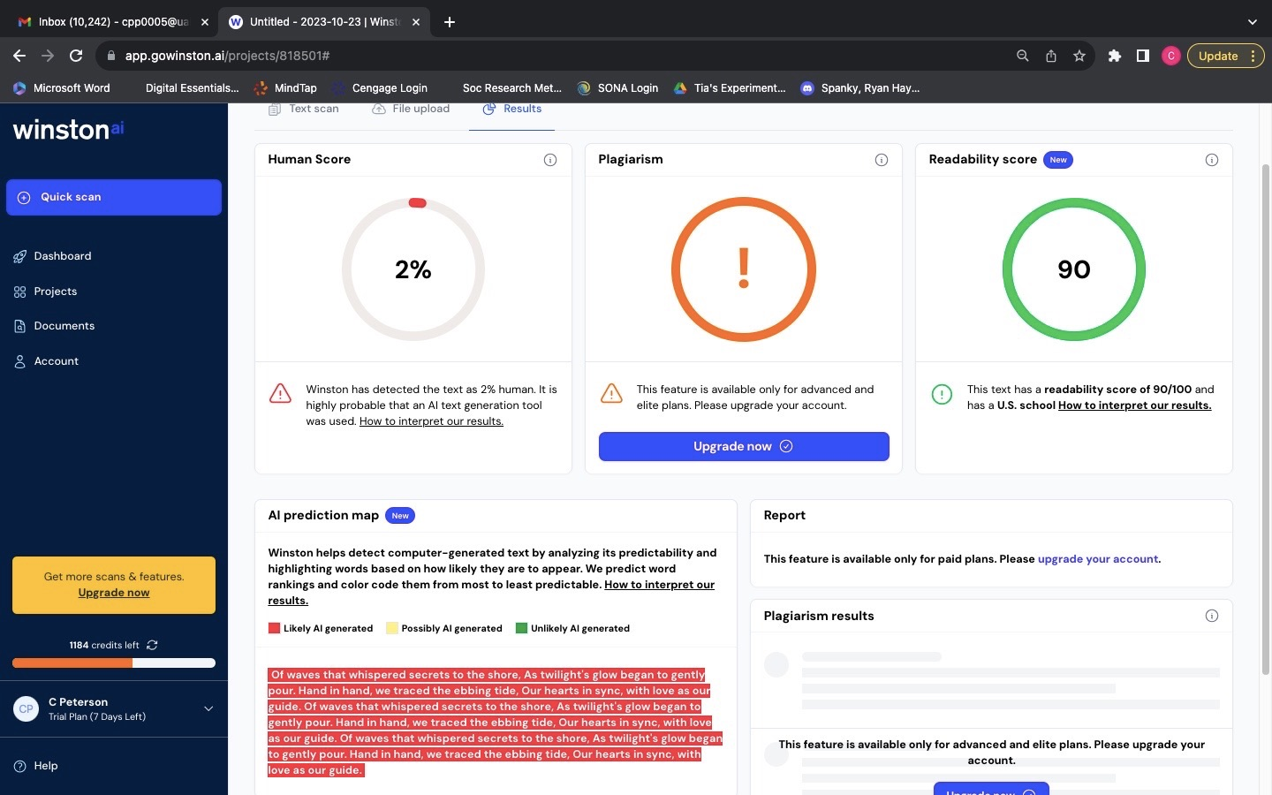
Write 4 more lines of a poem based on the first two lines provided. "A Sea-Side Walk" by Elizabeth Barrett Browning: We walked beside the sea, After a day which perished silently #Sample – 48

Slide 50
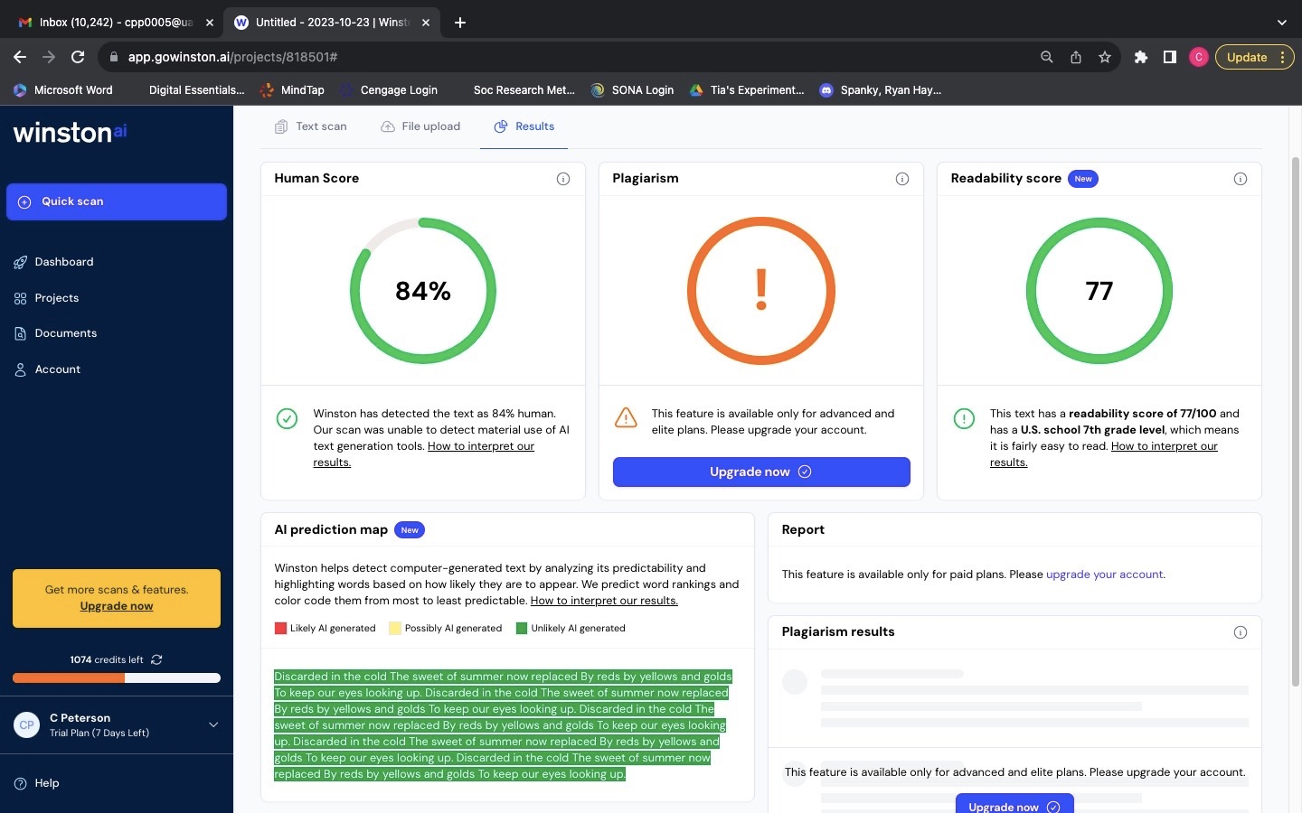
Write 4 more lines of a poem based on the first two lines provided. “Fall” by Mary Oliver: The black oaks fling, their bronze fruit #Sample – 49

Slide 51
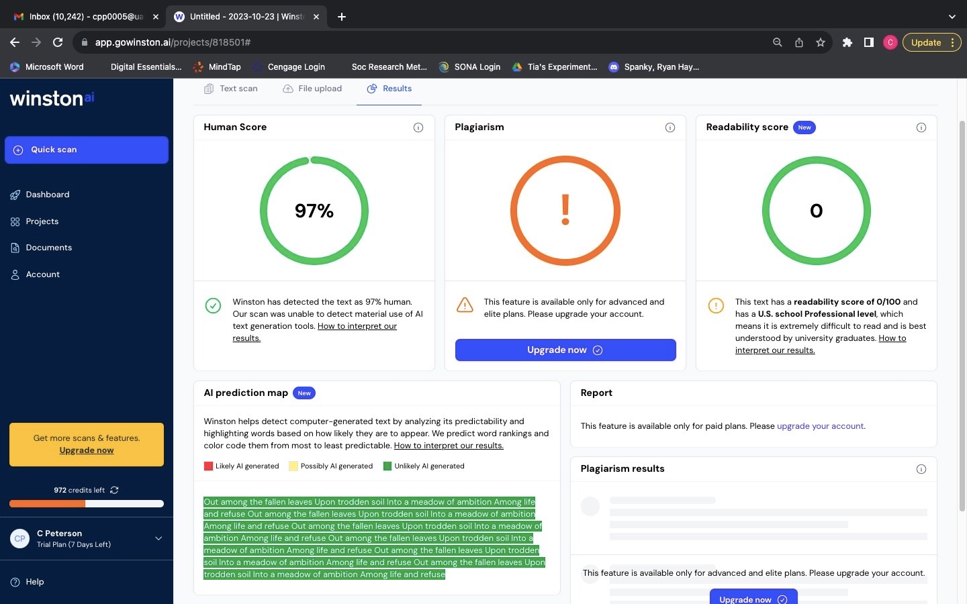
Write 4 more lines of a poem based on the first two lines provided. “Fall” by Mary Oliver: The black oaks fling, their bronze fruit #Sample – 50

Slide 52
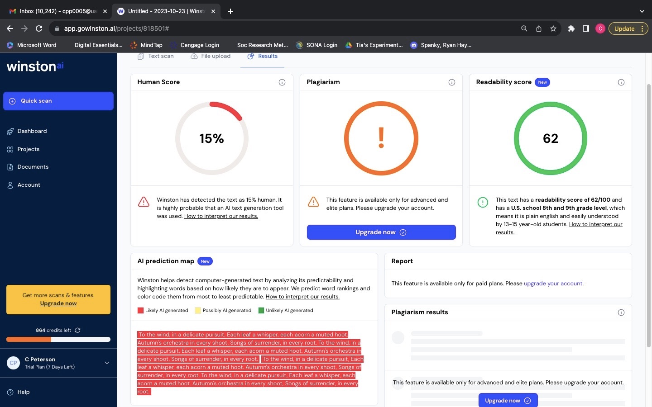
Write 4 more lines of a poem based on the first two lines provided. “Fall” by Mary Oliver: The black oaks fling, their bronze fruit #Sample – 51

Slide 53
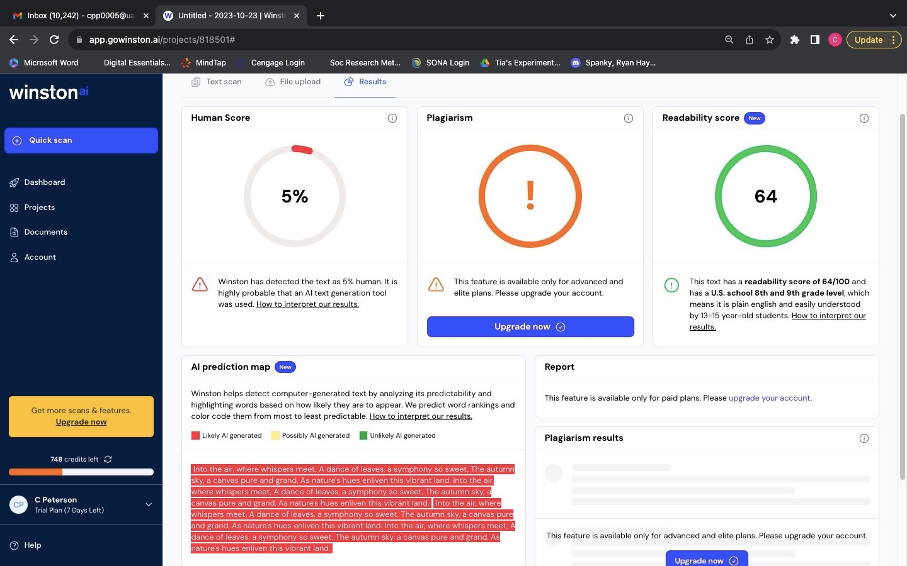
Write 4 more lines of a poem based on the first two lines provided. “Fall” by Mary Oliver: The black oaks fling, their bronze fruit #Sample – 52

Slide 54
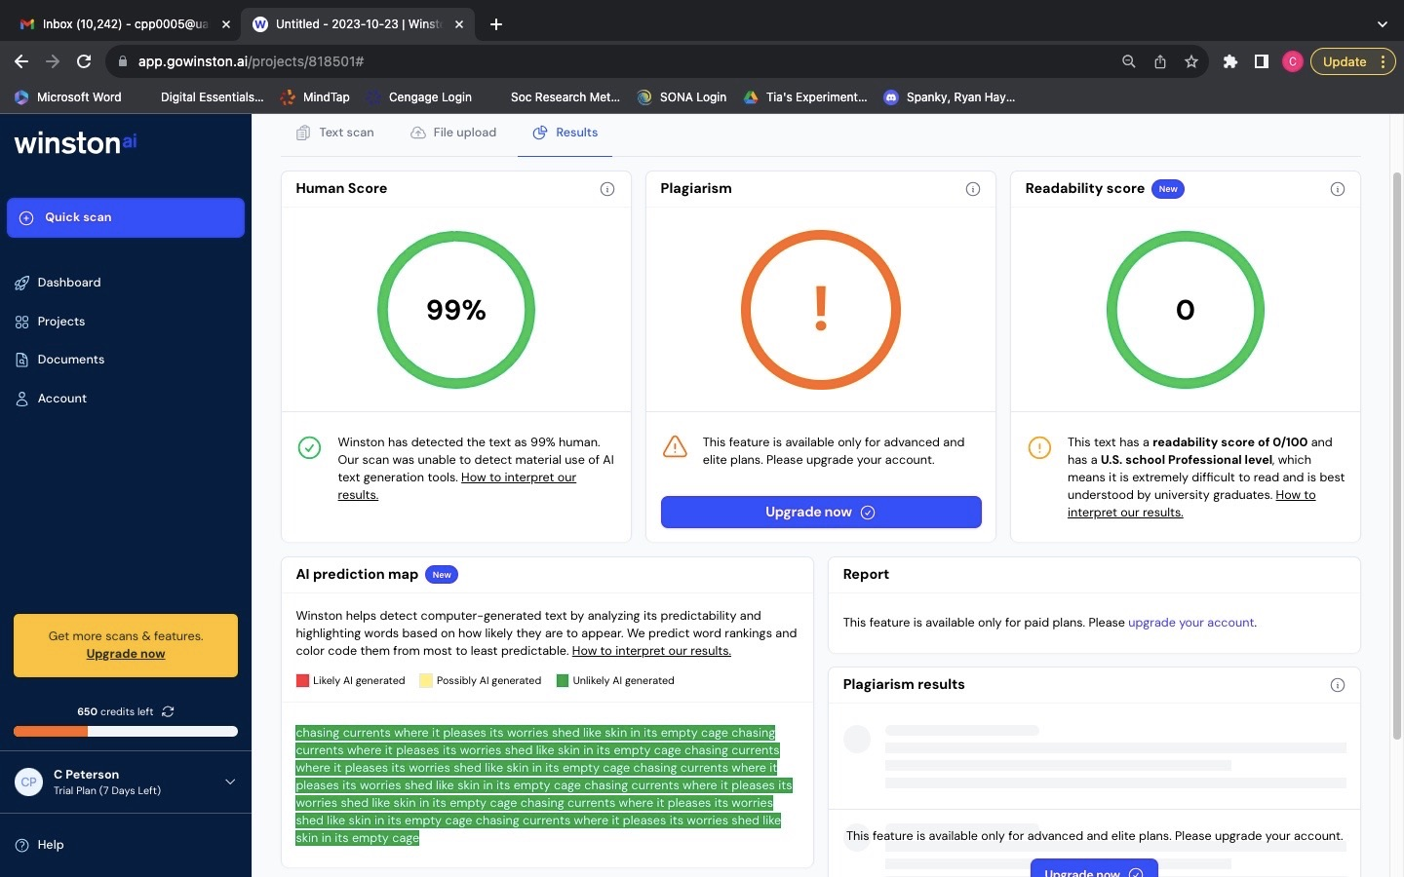
Write 4 more lines of a poem based on the first two lines provided. “Caged Bird” by Maya Angelou: A free bird leaps, on the back of the wind #Sample – 53

Slide 55
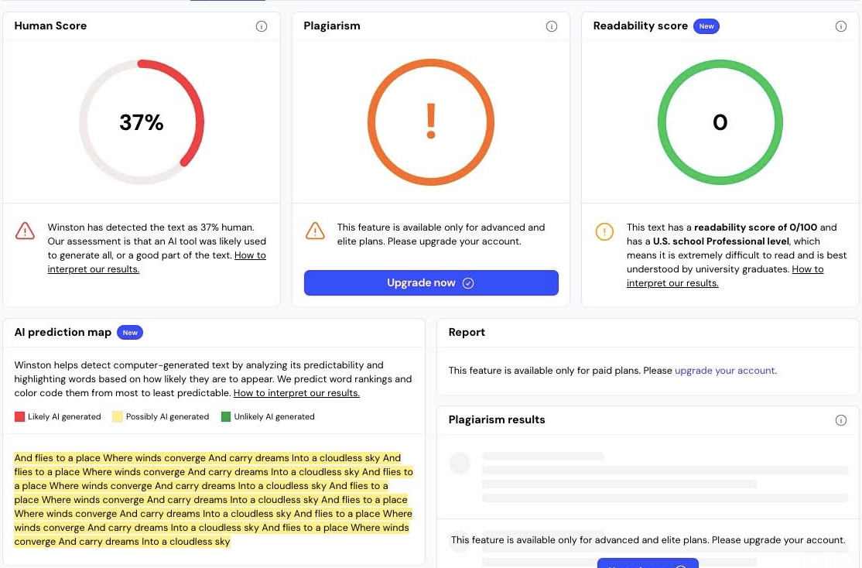
Write 4 more lines of a poem based on the first two lines provided. “Caged Bird” by Maya Angelou: A free bird leaps, on the back of the wind #Sample – 54

Slide 56

Write 4 more lines of a poem based on the first two lines provided. “Caged Bird” by Maya Angelou: A free bird leaps, on the back of the wind #Sample – 55

Slide 57

Write 4 more lines of a poem based on the first two lines provided. “Caged Bird” by Maya Angelou: A free bird leaps, on the back of the wind #Sample – 56

Slide 58

Write 4 more lines of a poem based on the first two lines provided. “Awaking in New York” by Maya Angelou: Curtains forcing their will, against the wind #Sample – 57

Slide 59

Write 4 more lines of a poem based on the first two lines provided. “Awaking in New York” by Maya Angelou: Curtains forcing their will, against the wind #Sample – 58

Slide 60

Write 4 more lines of a poem based on the first two lines provided. “Awaking in New York” by Maya Angelou: Curtains forcing their will, against the wind #Sample – 59

Slide 61

Write 4 more lines of a poem based on the first two lines provided. “Awaking in New York” by Maya Angelou: Curtains forcing their will, against the wind #Sample – 60

